Slide 1

Investing in

Slide 2


Introduction: Core message and Hypothesis
Why is AirBnB attracting so many investors?
How can we maximize the investment?
What are the key factors that assure a listing success?

Slide 3



The Data: Where and how did we get it?
Independent, non-commercial set of tools and data
Not associated with AirBnB or its competitors
Public information compiled from AirBnB listings
Hosts privacy is not compromised, only a few details are shared

Slide 4
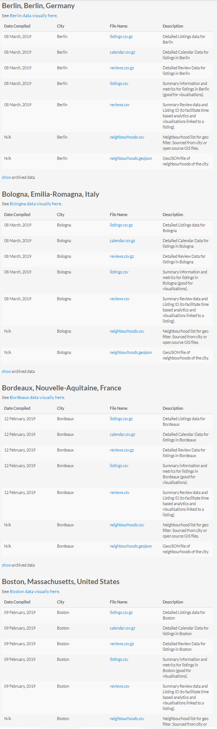
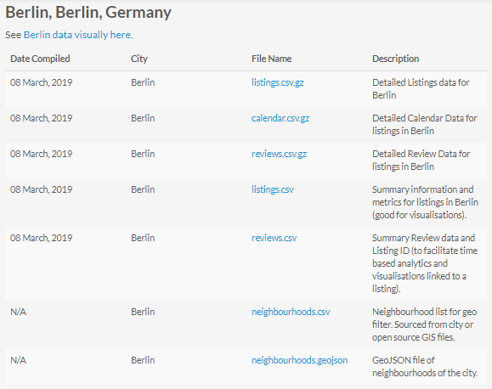
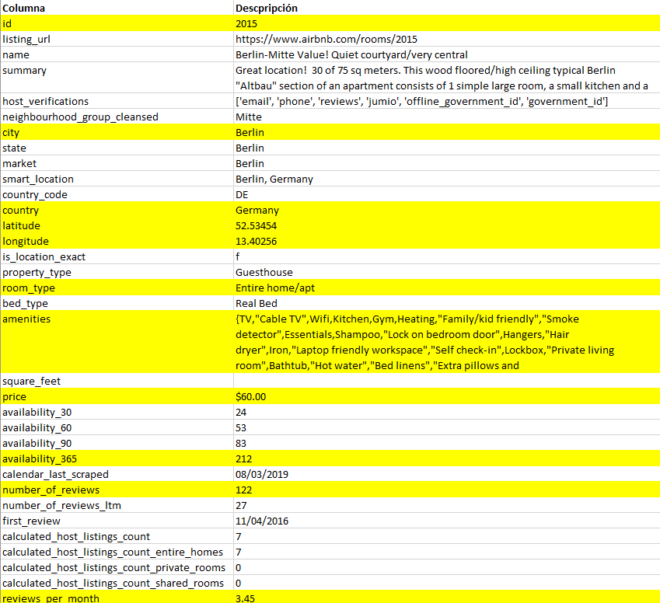
Data Set: Berlin
105 Columns
23,615 Rows
74.5 MB

Slide 5
Data Exploration and Cleanup Process

Slide 6
Data Exploration and Cleanup Process
Occupancy =
365 – Availability_365

Slide 7

Data Analysis

Slide 8
Conclusions
General analysis: Berlin is a good place to have an apartment AirBnB
Price vs Occupancy: Private rooms at a low price have a high occupancy
Location vs Price and Occupancy: Occupancy in and around expensive areas is higher
Ammenities vs Occupancy: top eight amenities in Berlin are: smoking allowed, hot tub, washer, buzzer, kitchen, cats, changing table, WiFi
Ratings vs Occupancy: listings with scores below 70 have a very low occupancy and the ones above 90 maximize the occupancy

